Slide 1
Introduction to AI & Problem Solving

Slide 2
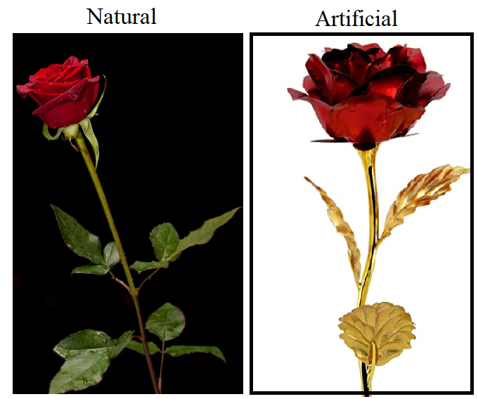

Meaning of Artificial:
Made or produced by human beings rather than occurring naturally, especially as a copy of something natural.
Artificial (man-made) is the state of being the product of intentional human manufacture, rather than occurring naturally.

Slide 3
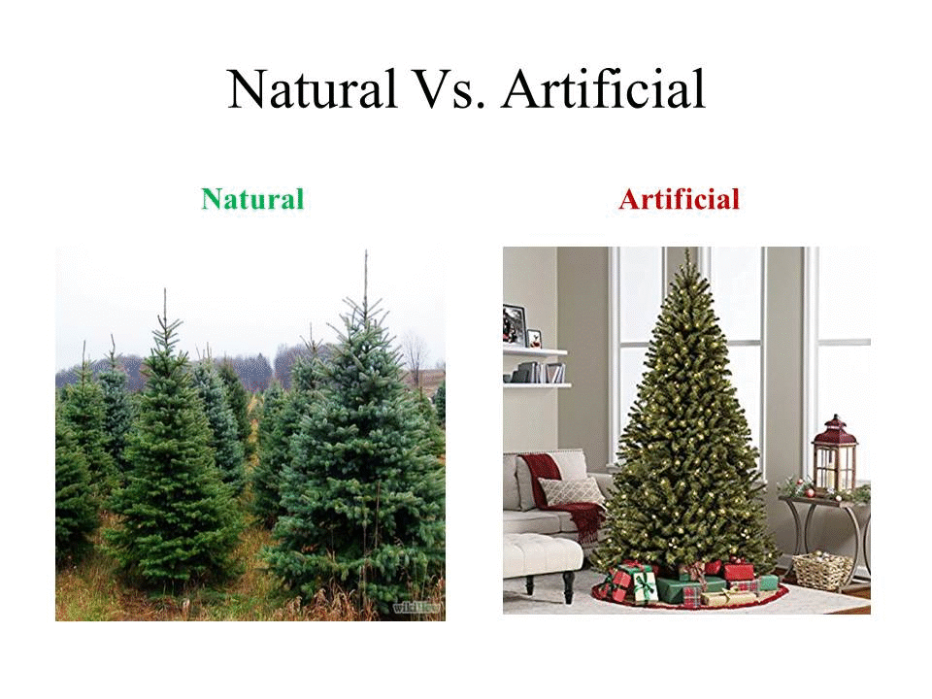

Slide 4
Meaning of Intelligence:
The ability to acquire and apply knowledge and skills.
The ability to understand, think and learn.
Ability to solve problems
Ability to plan and schedule
Ability to memorize and process information
Ability to answer fuzzy questions
Ability to recognize
Ability to perceive
And many more …

Slide 5
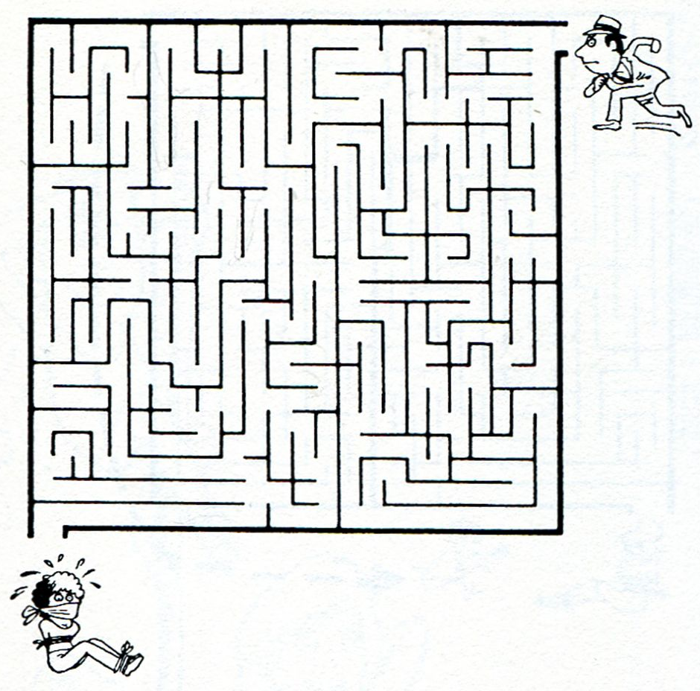
Intelligence Example 1:Searching a path
Different person might follow different paths based to their intelligence (In other words: The problem can be solved in many ways)

Slide 6
Can only humans beings and animals possess intelligence?
What else?
A machine searches through a mesh and finds a path?
A machine solves problems like the next number in the sequence?
A machine develops plans?
A machine diagnoses and prescribes?
A machine answers ambiguous questions?
A machine recognizes fingerprints?
A machine understands?
A machine perceives?
A machine does MANY MORE SUCH THINGS …
A machine behaves as HUMANS do? HUMANOID!!!

Slide 7
Artificial +Intelligence= Artificial Intelligence
You can say a machine or a system is artificially intelligent when it is equipped with at least one and at most all intelligences in it.
Artificial Intelligence is the study of how to make machines do things which at present human can do better.
Artificial Intelligence system works like a human brain, where a machine or software shows intelligence while performing given task.

Slide 8
Foundations of AI
In the foundation of AI there are four approaches
Thinking Humanly
Acting Humanly
Thinking Rationally
Acting Rationally

Slide 9
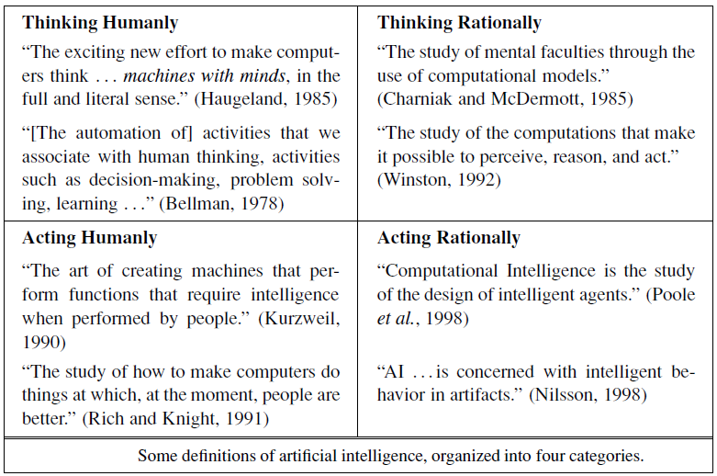
Thinking Humanly
Thinking Rationally
Acting Humanly
Acting Rationally

Slide 10
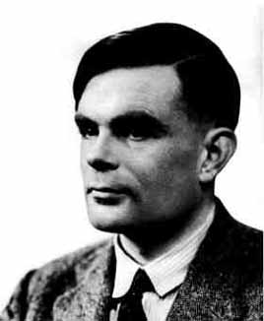
Foundations of AI: Acting Humanely
To judge whether the system can act like human, Sir Alan Turing had designed a test known as Turing Test.
Alan Turing:

Slide 11



Foundations of AI: Acting Humanly
Turing test:
In Turing test a computer interacts with the human interrogator by answering his/her questions in written/text format
Computer passes the test if a human interrogator can not identify whether the written responses are from a person or from computer.
Turing test is valid even after 60+ years of research
Interrogator

Slide 12
Foundations of AI: Acting Humanly
Turing test:
For this test, the computer requires following capabilities
Natural Language Processing
Knowledge representation
Reasoning
Machine Learning
Computer vision
Robotics

Slide 13
Foundations of AI: Thinking Humanly
In order to make machine think like human, first we need to understand how human think.
There are three patterns of human thinking process
Introspection: catch own thoughts
Psychological experiments: observing a person in action
Brain imaging: observing the brain in action
The thinking process of human can be implemented in computer systems as a program
If the program’s output matches with the human then the computer system can operate like human
e.g. Apple siri, Google assistant

Slide 14
Foundations of AI: Thinking Rationally
Rationality (By reasonable or logical means/In a sensible or logical manner)
Idealized or “right” way of thinking
e.g. “Tom is a man; all men are mortal; therefore Tom is mortal.”
If A=B and B=C then A=C
This approach is not suitable to use when 100% knowledge is not available for any problem
E.g. Google maps, (route navigation)

Slide 15
Foundations of AI: Acting Rationally
Rational Agent:
Agents perceive their environment through sensors and takes actions through actuators to achieve some specific goal.
A rational agent is one that does right things and act rationally so as to achieve the best outcome even when there is uncertainty in knowledge.
Rationality can be achieved by selecting the correct option from the several available
E.g. self driving car, roomba(automated vacuum)

Slide 16
Components of AI
Intelligence
Perception
Natural Language Processing
Knowledge representation
Problem Solving
Reasoning and Learning

Slide 17
Components of AI
Perception:
Knowledge representation
Learning
Reasoning
Problem Solving
Natural Language Processing

Slide 18

Components of AI: 1. Perception
The ability to see, hear, or become aware of something through the senses.
The way in which something is regarded,
understood, or interpreted.
Intelligent agents need to scan the environment and the various object in it.
Agent scans the environment using various sense organs like camera, temperature sensor etc.
Then it analyses the different objects in it, extract their features and relationship among them.

Slide 19
Components of AI: 2. Knowledge representation
The information obtained from environment through sensors may not be in the required format
For further processing (learning various patterns, deducing inference, comparing with past objects) the information needs to be in standard formats.
There are various knowledge representation techniques like Propositional logic, First order logic etc.

Slide 20
Components of AI: 3. Learning
The acquisition of knowledge or skills through study, experience, or being taught.
Human learning begins before birth and continues until death
Learning is a very essential part of AI also
The simplest form of learning is by trial and error. It is also called as Unsupervised learning
On the other hand solution to few of the problems is given as input to the system, on the basis of that a program generate solutions for new problems. This is known as supervised learning

Slide 21
Components of AI: 4. Reasoning
The action of thinking about something in a logical, sensible way.
Reasoning is also called as logic or generating inferences from the given set of facts
Reasoning is carried out based on strict rules
E.g. if A=B and B=C then A=C
Since all humans are mortal, and I am a human, then I am mortal.
To earn a master’s degree, a student must have 32 credits. Tom has 40 credits, so Tom will earn a master’s degree.

Slide 22
Components of AI: 5. Problem Solving
To find a solution to a difficult or complex question or situation, AI addresses huge verity of problems
E.g. identification of various objects from given image
As per the type of problem, there is verity of problem solving strategies in AI
E.g. finding shortest path between source and destination

Slide 23
Components of AI: 6. Natural Language Processing
It concerned with the interactions between computers and human (natural) languages
It involves machines to understand and process the human language and infer knowledge from the speech input
It also involves the active participation(text/verbal output) from machine

Slide 24
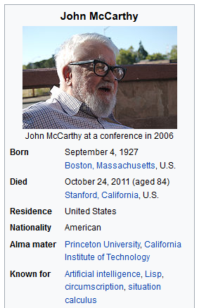
History of AI
The term Artificial Intelligence
is introduced by John McCarthy, in 1955.
Mathematician Alan Turing and others
presented a study based on logic driven
computational theories
Research on Automations, Neurology,
Control Theory and Information Theory
inspired a group of researchers to think about
the possibility of creating an electronic brain

Slide 25

History of AI
In the year 1956 a conference was conducted at the campus of Dartmouth College(USA) where the field of AI research was discussed.
This conference was attended by John McCarthy, Marvin Minsky, Allen Newell and Herbert Simon etc. who are supposed to be the pioneers of AI research
During the time period, AI systems were developed by these researchers and their students.

Slide 26
Applications of AI:
Education
Entertainment
Medical
Heavy Industry
Applications of AI
Military
Voice Technology
Automated Planning and Scheduling
Business & Manufacturing

Slide 27
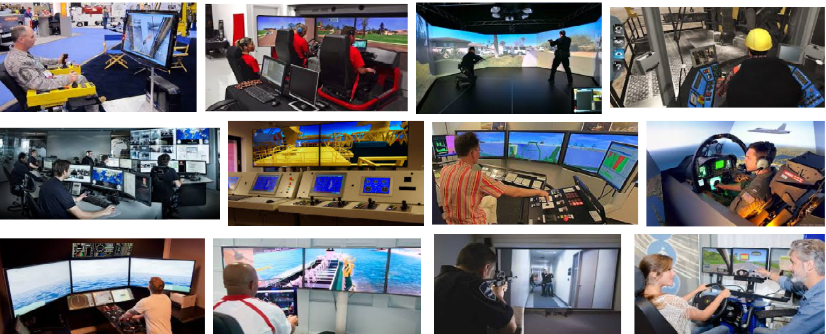
Applications of AI: Education
Training simulators can be done by using AI techniques

Slide 28

Applications of AI: Education
Software's for pre-school children are developed to enable learning with fun games
Handwriting recognition

Slide 29
Applications of AI: Education
Automated grading, interactive tutoring, instructional theory are the current areas of applications
In sports as an expert opponent

Slide 30
Applications of AI: Education
Seeing AI: Making the visual world more accessible

Slide 31
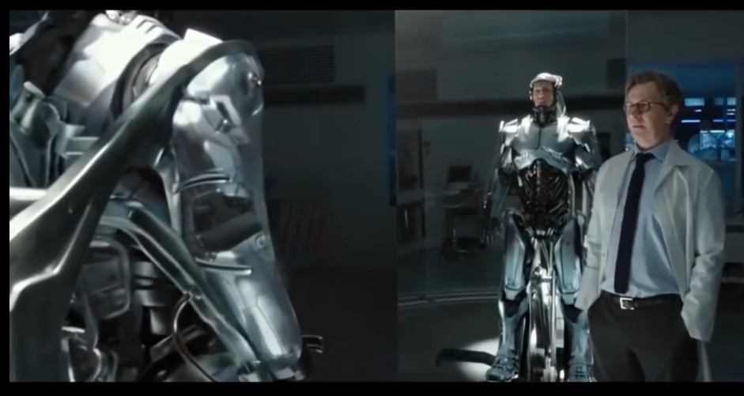
Applications of AI: Entertainment
In many SCI-FI movies, games robots are designed to play as characters
In many games AI agents can play as an opponent when human player is not available

Slide 32
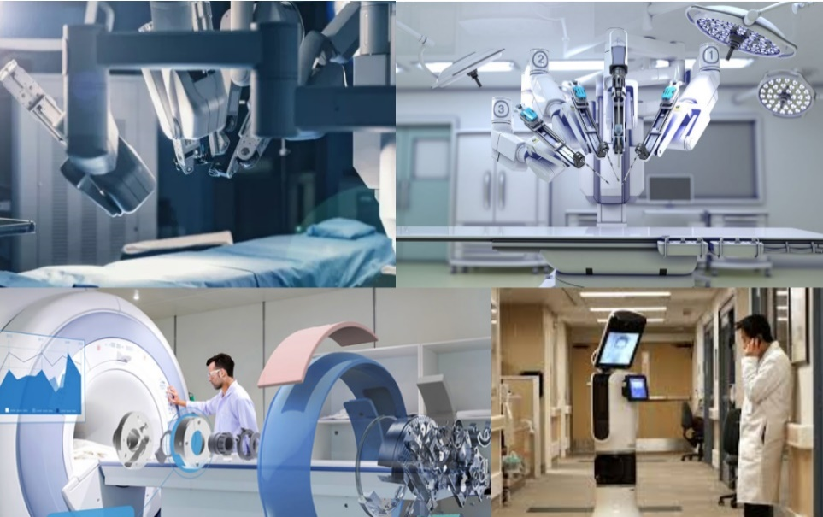
Applications of AI: Medical
AI has applications in the field of
Cardiology(CRG)
Neurology(MRI)
Embryology(Sonography)
Complex operations of internal organs etc.
AI can also used for Hospital management
Many expert systems of AI are enabled to predict the decease and provide medical prescription also
E.g. MYCIN AI Expert System

Slide 33
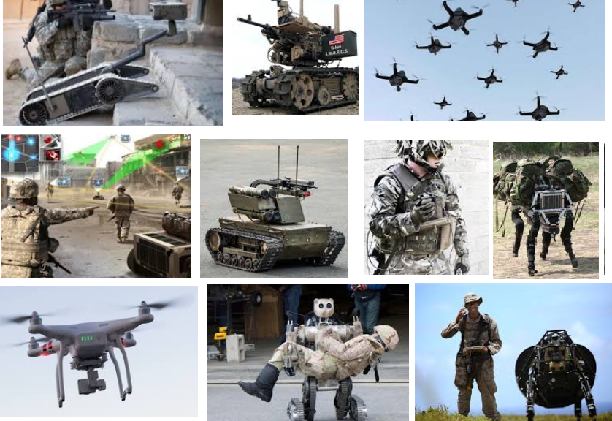
Applications of AI: Military
Areas where human can not reach or in life stacking conditions, robots can be used to do the required jobs.
AI can provide crucial assistance in war like situations by using enormous amount of information
Can be used to defuse mines, bombs etc.

Slide 34
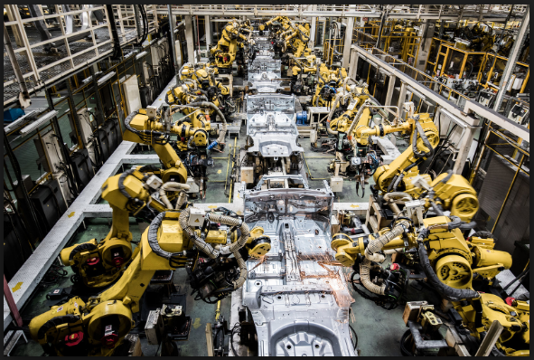
Applications of AI: Business and Manufacturing
Today’s robots are not only working faster and more reliably than the human but also performing tasks beyond human capability altogether e.g.Alibaba's smart warehouse

Slide 35
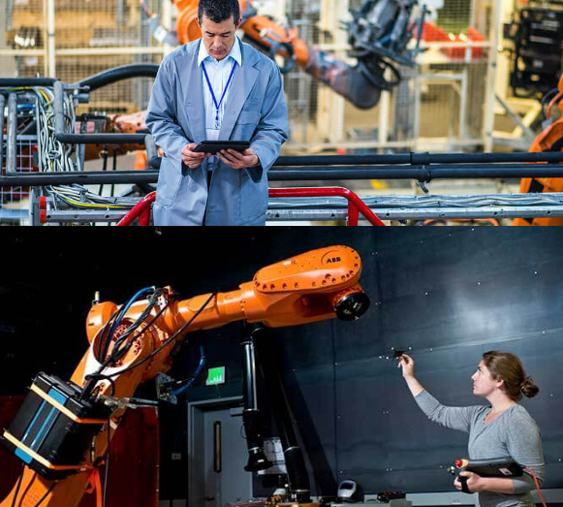
Applications of AI: Business and Manufacturing

Slide 36
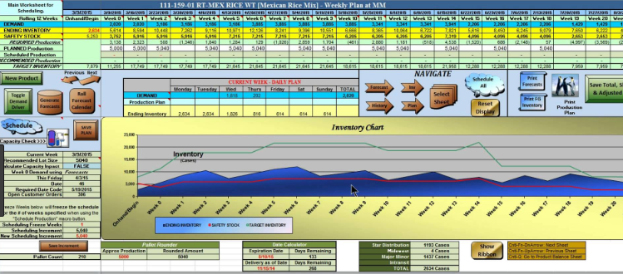
Applications of AI: Automated planning and scheduling
Intelligent planners are available with AI systems, which can process large datasets and can consider all the constraints to design plans satisfying all of them

Slide 37

Applications of AI: Voice Technology
Voice recognition is improved a lot with AI.
Systems are designed to take voice inputs which are very much applicable in case of handicaps
Also scientists are developing an intelligent machines to emulates activities of a skillful musician
Composition, performance, sound processing, music theory are some of the major areas of research

Slide 38
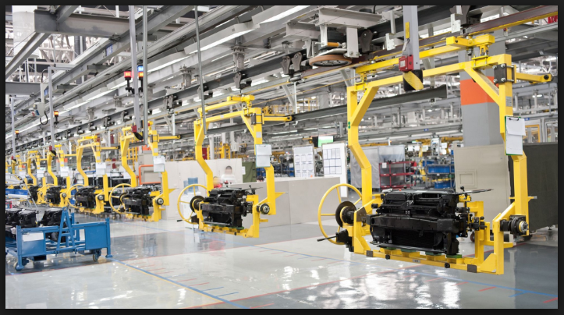
Applications of AI: Heavy Industry
Huge machines involve risk in operating and maintaining them
Humanoid robots are better replacing human operators, these robots are safe and efficient
Humans may fail in repetitive nature jobs due to lack of continuous attention or laziness but robots are efficient

Slide 40
Objectives
To define Agent and its structure
To understand environment and nature of environment
To learn different types of agents
Simple reflex agent
Model-based reflex agent
Goal-based agents
Utility-based agents
Learning agents

Slide 41
What is an Agent?
Agent is something that perceives its environment through sensors and acts upon that environment through effectors or actuators.
To understand Agent, We need to know Meaning of
Sensors
Effectors
Actuators
Perception
Action
Environment

Slide 42
An Agent
Simple example of Agent: Consider human as an agent
Sensors : Eyes, Nose, Skin(touch), Tongue, Ears
(sensors sense the environment and passes it to the processing unit)
Effectors/Actuators : Hands, Legs, Mouth(speak)
(Effectors/Actuators are the tools by using which agents acts upon the environment)
Perception: collection of information from environment through sensors
(The way in which something is regarded, understood, or interpreted)
Action: is the output given to the environment from agent
Environment: the surroundings or conditions in which a agent operates

Slide 43
An Agent
Consider Robot as an agent
Sensors : Cameras, infrared range finders, sound recorders
Effectors/Actuators : Motors, Output screens, printing devices

Slide 44
An Agent
Agent is not only a robot
It may be a program
It may be a software
It may be any physical device (e.g. automated driving car)
It may be a any specific hardware(robotic arm)
e.g. opponent of computer game

Slide 45
Agents Terminologies
Performance of Agent: It is the criteria, which determines how successful an agent is.
Behaviour of an Agent: It is the action that agent performs after any given sequence of percept's.
Percept: It is agent’s perceptual inputs at a given instance.
Percept Sequence: It is the history of all that an agent has perceived till date.

Slide 46
Agent function
An agent function is the description of what all functionalities the agent is supposed to do/perform
The agent function provides mapping between percept sequence to the desired actions

Slide 47
Agent Program
An agent program is a computer program that implements agent function in an architecture suitable language
Agent programs needs to be installed on a device in order to run the device accordingly(e.g. AC, Freeze, remote control etc.)
The device must have some form of sensors to sense the environment and actuators to act upon it.
Hence agent is a combination of the architecture hardware and software program
Agent=Architcure(Hardware)+Program
Lets discuss example of vacuume cleaner in detail

Slide 48
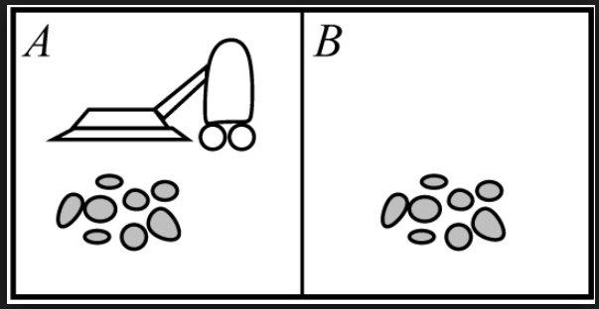
Vacuume cleaner agent
Lets understand how to represent the
percept's(inputs) and actions(output) used in
case of a vacuume cleaner.
Suppose there are two blocks (A and B having some dirt) as shown in diagram
To clean the room, Vacuume cleaner agent suppose to sense the dirt and collect it
In order to do that agent must have camera to see dirt and a mechanism to move forward, backward, left and right to reach to the dirt
Also it should have a mechanism to absorb the dirt

Slide 49
Vacuume cleaner agent
Based on the percept action will be
Performed. E.g Move left, Move right,
Absorb, No operation etc.
Sensor for the vacuume cleaner agent can be camera, dirt sensor
Actuators are Motors to move and absorption mechanism
The operations can be represented by
[A,Dirty],[B,Clean],[A,Absorb],[B,Nop] etc.

Slide 50
Structure of Intelligent agent
Q. What is intelligent agent? explain the structure of intelligent agent?
Intelligent Agent:
It is the one which can take input from the environment through its sensors and acts upon the environment through its actuators. Its actions are always directed to achieve goal
Basic abilities of intelligent agent are:
To remain autonomous(self-governed)
Responsive
Goal-oriented

Slide 51
Structure of Intelligent agent
Observe the input
Perception
Scan DB for corresponding action
Enviro-nment
Agent
Database of input and actions
Action
Action is given as output
Set internal state to the appropriate action

Slide 52
Structure of Intelligent agent
The agent first observes the environment through its sensors and get the input
Environment may change
Then scans the DB of inputs and actions (for corresponding action)
e.g. hot pan
The agent keeps taking input from the environment and goes through these states every time
Agent’s structure can be viewed as:
Agent = Architecture + Agent Program
Architecture = the machinery that an agent executes on.
Agent Program = an implementation of an agent function.

Slide 53
Environment and its types
Environment is nothing but the surroundings or conditions in which an agent operates
Fully Observable Vs. Partially Observable
Single agent Vs. Multiple agents
Deterministic Vs. Non-deterministic
Episodic Vs. sequential
Static Vs. Dynamic
Discrete Vs. Continuous
Known Vs. Unknown

Slide 54
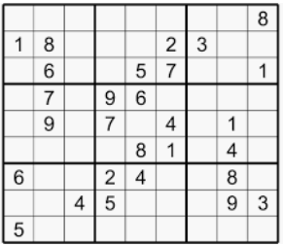
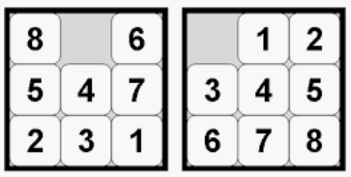
Environment types: Fully Observable Vs. Partially Observable
In fully observable environments agents are able to gather all the necessary information required to take actions.
Agents don’t have to keep records of internal states
e.g. 8-puzzle problem, Sudoku puzzle etc.

Slide 55
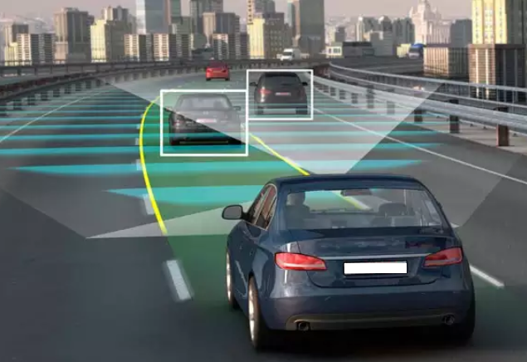
Environment types: Fully Observable Vs. Partially Observable
Environments are called partially observable when sensors can not provide errorless information as the environment is not seen completely at any point of time
e.g. automated car (can not predicts what the other drivers are thinking)

Slide 56
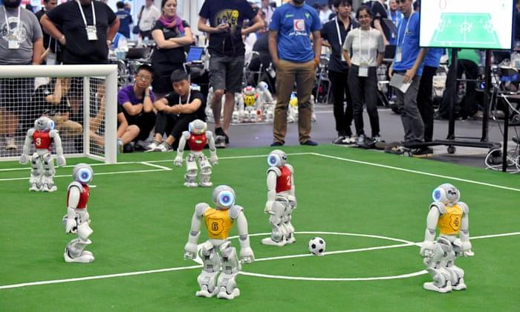
Environment types: Single agent Vs. Multiple agents
It is based on the number of agents acting in the environment
In single agent environment the agent operating on its own
e.g. vacuume cleaner agent
In multiagent environment an agent operates in collaboration with other agents
e.g. automated car driving agent(multiple agents driving on road)

Slide 57

Environment types: Deterministic Vs. Non-deterministic
If the next state of the environment is completely determined by the current state and the actions of the agent, then the environment is deterministic
e.g. chess game
(next step is depend on current state)
The next state of the environment is not depends on the current state, and there are few changes happening in the environment irrespective of the agents action
e.g. automated car driving system(can not control the traffic conditions on the road)

Slide 58
Environment types: Episodic Vs. sequential
An episodic task environment is the one where each of the agents action is divided into episodes
The current episode is different than the previous episode and there is no dependency between them
In each episode the agent receives an input from environment and then perform a corresponding action
e.g. classification tasks (pick up and place from the conveyor belt)
every time agent will check assembled parts of a component and acts
In sequential environments the previous decision can affect all future decisions
The next action of the agent depends on what action he has taken previously
e.g. if automatic car driving agent is initiating breaks then he has to release accelerator, press clutch and lower down the gear as next actions

Slide 59
Environment types: Static Vs. Dynamic
If an environment remains unchanged while the agent is performing given task then it is called as a static environment
e.g. vacuume cleaner environment, Sudoku puzzle environment
If the environment is not changing over the time but an agents performance is changing then it is called as semi-dynamic environment.
e.g. chess game
If the environment changes while an agent is performing some task then it is called dynamic environment.
e.g. automatic car driving agent

Slide 60
Environment types: Discrete Vs. Continuous
When there are distinct and clearly defined inputs and outputs then it is called discrete environment.
e.g. chess environment has finite number of distinct inputs and outputs/actions
When there are continuous inputs from environment and action can not be defined/predicted then it is called continuous environment
e.g. Automatic car driving system

Slide 61
Environment types: Known Vs. Unknown
In known environment the output of all probable actions is given
e.g. tic-tac-toe game
In unknown environment agent has to find output, make decisions and it has to gain knowledge about- how the environment works.
e.g. automated car driving agent

Slide 62
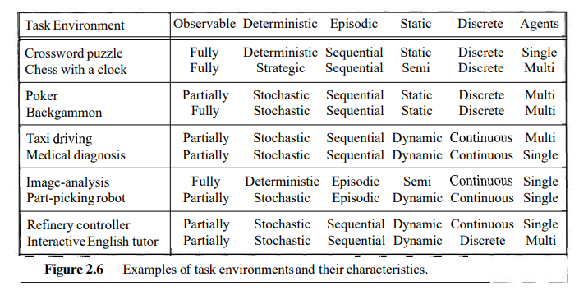

Slide 63
PEAS Properties
What is PEAS stands for
P: Performance Measure (what is the expected output)
E: Environment
A: Actuators/Effectors
S: Sensors

Slide 64
PEAS Properties of Automated Taxi Driver Agent
P: Performance Measure (what is the expected output)
Getting to correct Destination
Less cost
High Safety
E: Environment
Varity of roads
Traffic
Different types of passengers
A: Actuators/Effectors
Accelerator
Steering
breaks
S: Sensors
Camera
GPS
IR sensors

Slide 65
PEAS Properties of Medical Diagnosis System
P: Performance Measure (what is the expected output)
Healthy Patients
Minimum cost
E: Environment
Patients
Doctors
Hospital
Staff
A: Actuators/Effectors
Screen display, printers
Questions test
Treatment
S: Sensors
Keybord (entry of symptoms)

Slide 66
Artificial Intelligence Vs Machine Learning
Artificial Intelligence (AI) refers to the simulation of human intelligence in machines, which are designed to perform tasks that typically require human-like intelligence.
Machine Learning (ML) is a subset of AI that involves the use of algorithms and statistical models to enable machines to improve from experience without being explicitly programmed.
In other words, ML allows machines to learn from data, identify patterns, and make decisions with minimal human intervention. So, Machine learning is a method for achieving AI, but AI is a broader concept that encompasses other methods as well.

Slide 67
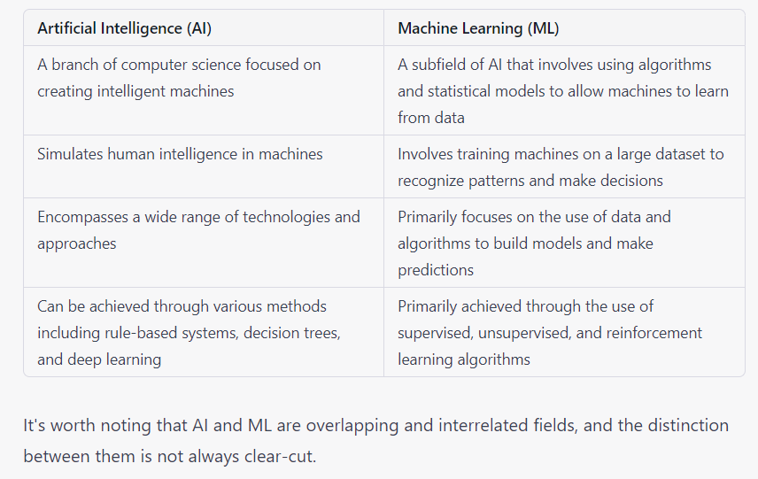
Artificial Intelligence Vs Machine Learning

